Slide 1

BERT:
Pre-training of Deep Bidirectional Transformers for
Language Understanding
Jacob Devlin, Ming-Wei Chang, Kenton Lee, Kristina Toutanova
Google AI Language
{jacobdevlin,mingweichang,kentonl,kristout}@google.com
May 2019
Mark Erokhin (mark.erokhin@study.thws.de);
Anastasiia Demidova (anastasiia.demidova@study.thws.de)

Slide 2
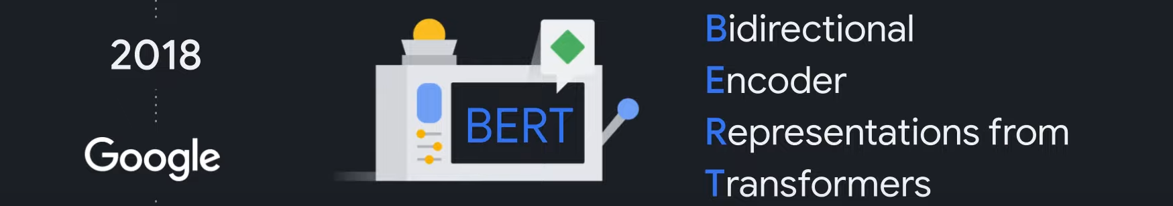
The contributions of the paper

Slide 3
The contributions of the paper
Importance of bidirectional pre-training for language representations

Slide 4
The contributions of the paper
Importance of bidirectional pre-training for language representations
Pre-trained representations reduce the need for many heavily-engineered task specific architectures

Slide 5
The contributions of the paper
Importance of bidirectional pre-training for language representations
Pre-trained representations reduce the need for many heavily-engineered task specific architectures
BERT advances the state of the art for 11 NLP tasks

Slide 6
Pre-trained representations
Pre-trained representations
Context-free
Contextual
word2vec
GloVe
Unidirectional
Bidirectional

Slide 7


Pre-trained representations
Pre-trained representations
Context-free
Contextual
word2vec
GloVe
Unidirectional
Bidirectional
bank
OpenAI GPT
BERT
bank deposit
river bank

Slide 8
Pre-trained representations
Pre-trained representations
Context-free
Contextual
word2vec
GloVe
Unidirectional
Bidirectional
bank
OpenAI GPT
bank
BERT
bank deposit
river bank
I made a (bank) deposit
I made a
deposit

Slide 9
Pre-trained representations
Pre-trained representations
Context-free
Contextual
word2vec
GloVe
Unidirectional
Bidirectional
bank
OpenAI GPT
bank
BERT
bank deposit
river bank
I made a (bank) deposit
I made a
I made a ... deposit
deposit

Slide 10
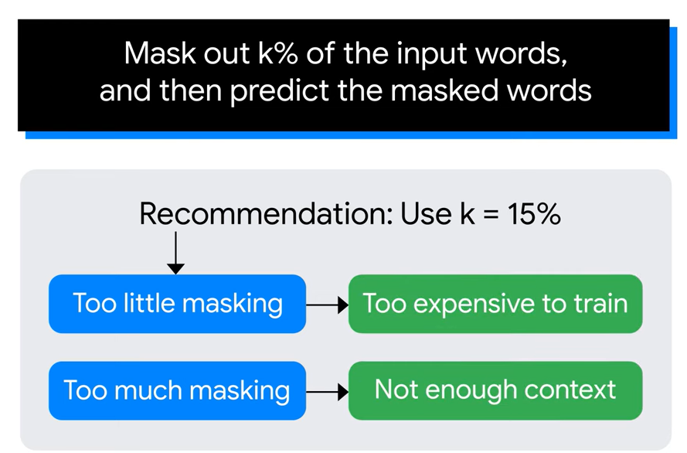
Pre-training. Task#1. Masked language modeling (MLM)

Slide 11
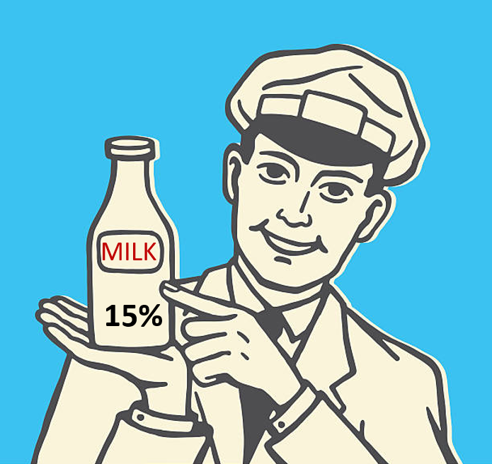
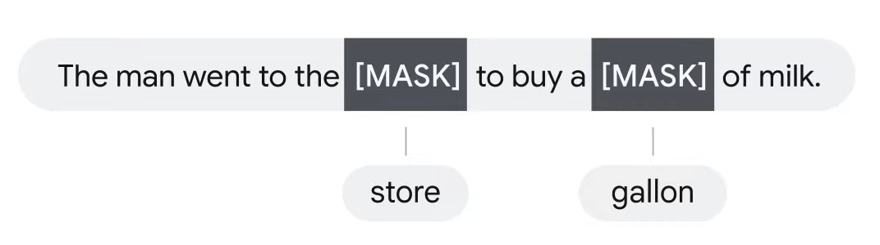
Pre-training. Task#1. Masked language modeling (MLM)

Slide 12

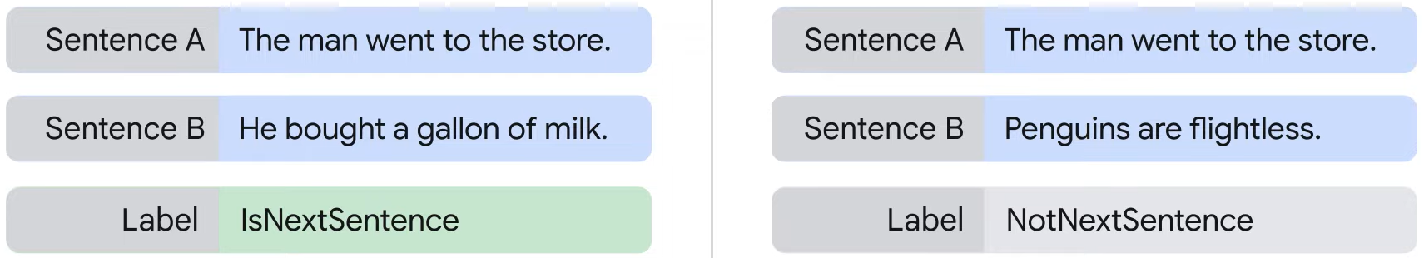
Pre-training. Task#2. Next sentence prediction (NSP)
is B the actual next sentence that comes after A,
or just a random sentence from the corpus?

Slide 13
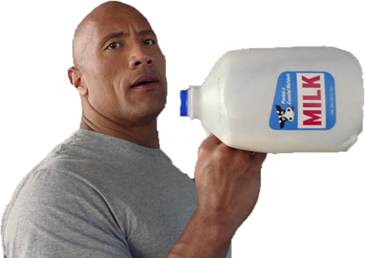
Pre-training. Task#2. Next sentence prediction (NSP)
is B the actual next sentence that comes after A,
or just a random sentence from the corpus?

Slide 14

Pre-training. Task#2. Next sentence prediction (NSP)
is B the actual next sentence that comes after A,
or just a random sentence from the corpus?

Slide 15
Pre-training. Task#2. Next sentence prediction (NSP)

Slide 16
Pre-training. Task#2. Next sentence prediction (NSP)
50% / 50%

Slide 17

Pre-training. Task#2. Next sentence prediction (NSP)
50% / 50%

Slide 18
Pre-training. Task#2. Next sentence prediction (NSP)
50% / 50%

Slide 19
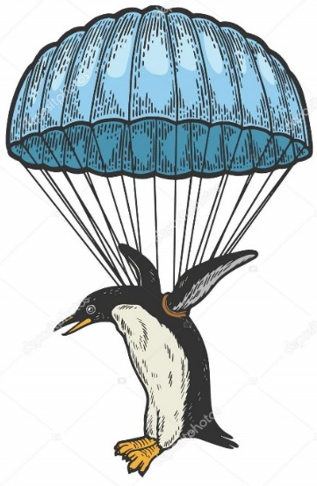
Pre-training. Task#2. Next sentence prediction (NSP)
Learn the relationships between sentences and predict the next sentence given the first one

Slide 20
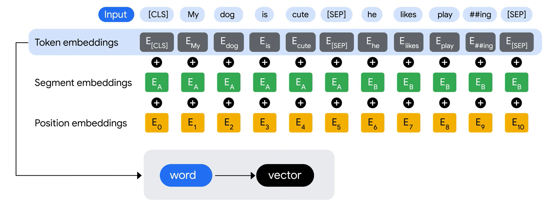
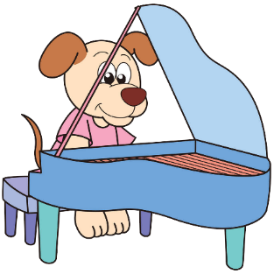
Input/Output Representations
The input embeddings are the sum of the token embeddings, the segmentation embeddings and the position embeddings

Slide 21
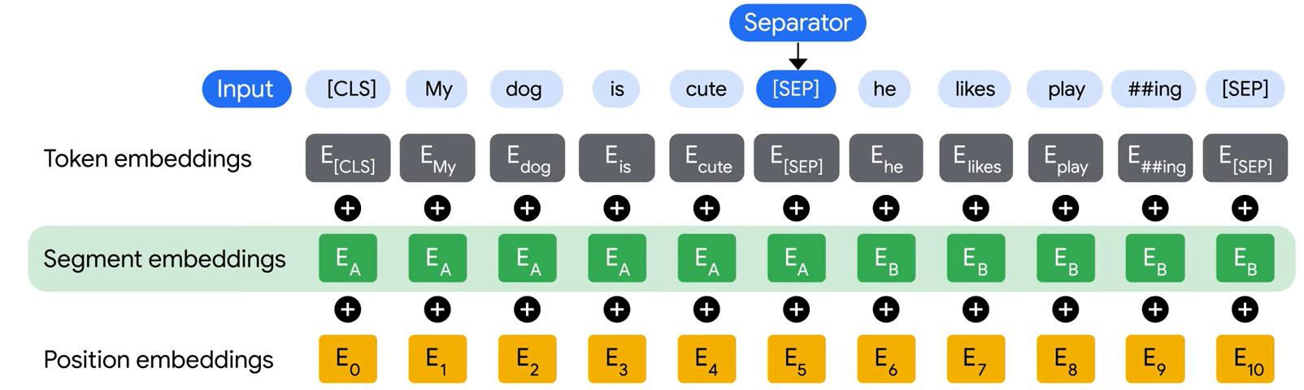
Input/Output Representations
The input embeddings are the sum of the token embeddings, the segmentation embeddings and the position embeddings

Slide 22
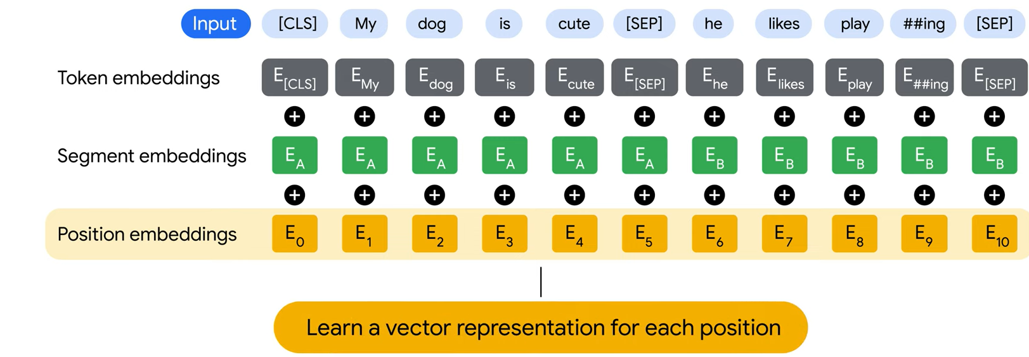

Input/Output Representations
The input embeddings are the sum of the token embeddings, the segmentation embeddings and the position embeddings

Slide 23
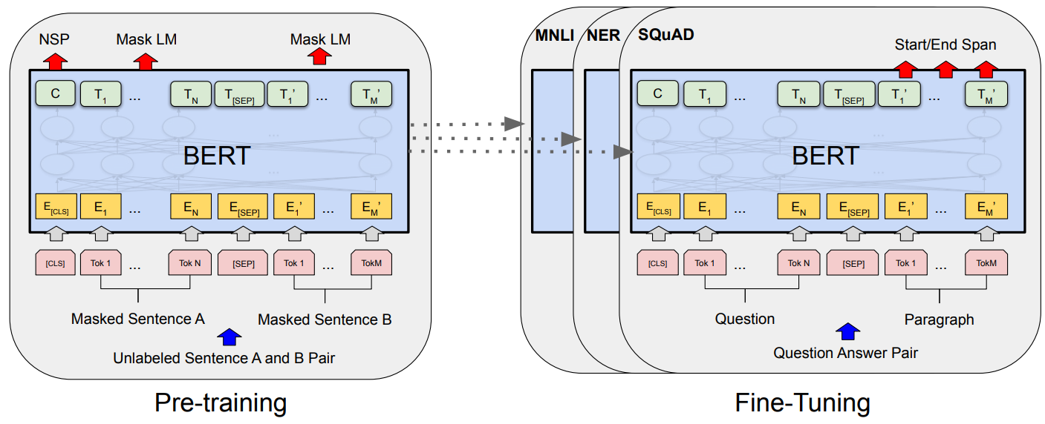
Overall pre-training and fine-tuning procedures for BERT

Slide 24
Overall pre-training and fine-tuning procedures for BERT

Slide 25
Overall pre-training and fine-tuning procedures for BERT

Slide 26
Overall pre-training and fine-tuning procedures for BERT

Slide 27
Overall pre-training and fine-tuning procedures for BERT
to understand language
to learn specific tasks

Slide 28
Overall pre-training and fine-tuning procedures for BERT
to understand language
to learn specific tasks

Slide 29
Overall pre-training and fine-tuning procedures for BERT
to understand language
to learn specific tasks

Slide 30
Overall pre-training and fine-tuning procedures for BERT
to understand language
to learn specific tasks

Slide 31
Overall pre-training and fine-tuning procedures for BERT
to understand language
to learn specific tasks

Slide 32
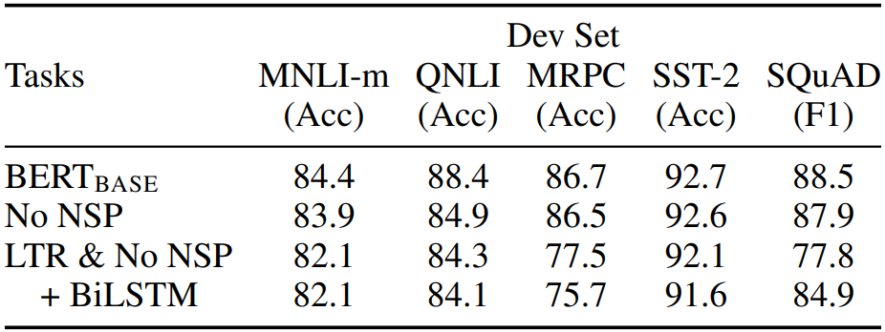
Effect of Pre-training Tasks
“No NSP” is trained without the next sentence prediction task.
“LTR & No NSP” is trained as a left-to-right LM without NSP (like OpenAI GPT).

Slide 33


Thank you for
your attention

